Slide 1
Research Proposal

Slide 2
Content
Introduction
Research proposal content
Project title, project summary and Background
Ethical issues
Research plan, methodology, timing
Budget and justification
Research team
Research timeline

Slide 3
Objectives
To understand how to write a research proposal
To understand the structure of research proposal
To understand how to cite literatures
To understand how to write citation and reference

Slide 4
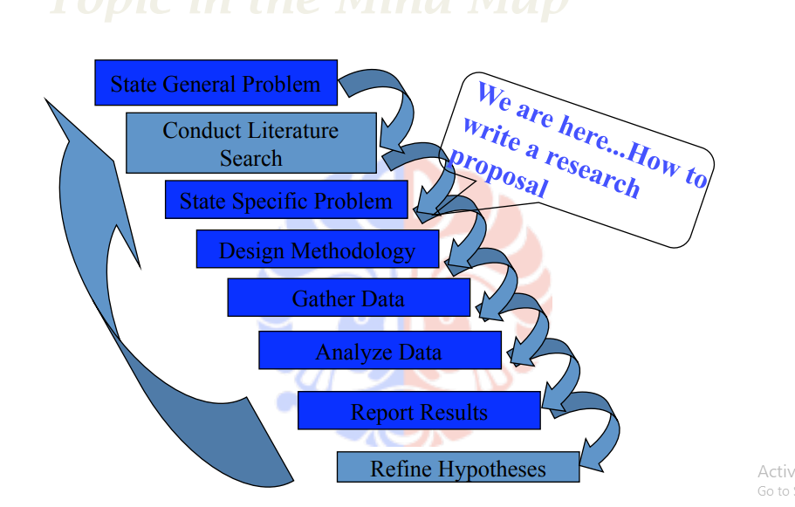
Where we are?

Slide 5
What is Research Proposal?
After you have ideas, then you can state the general problems or general issues of your “research” interest
Elaborate the problems by reviewing literatures
Make sure the problems are worth of research
See previous course‐material: how to review literatures
Design steps to solve the problems‐‐ methodology
Use all related theories, methods, techniques, processes, procedures, tools, etc., found in the

Slide 6
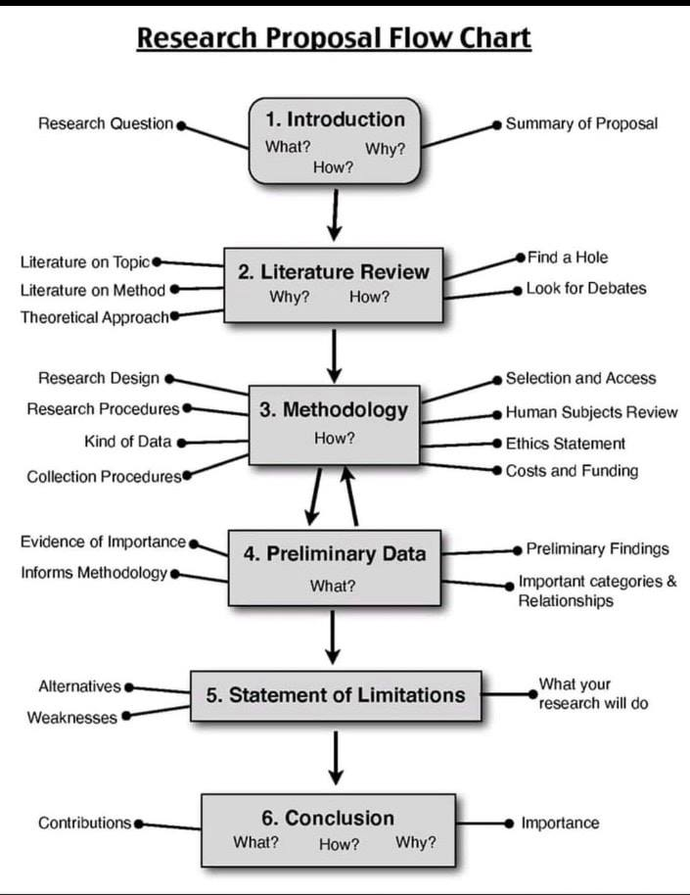
RESEARCH PROPOSAL FLOW CHART

Slide 7
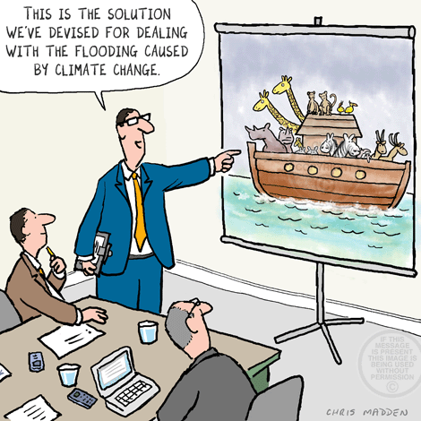
Introduction
A research proposal is an overall plan, scheme, structure and strategy designed to obtain answer to the research question
Ensures the reviewers of the validity of the methodology for obtaining answers to your research questions accurately and objectively.
Explain to your research supervisor and reviewers the following information about your study:
what you are proposing to do;
how you plan to find answers to what you are proposing;
why you selected the proposed strategies of investigation

Slide 8
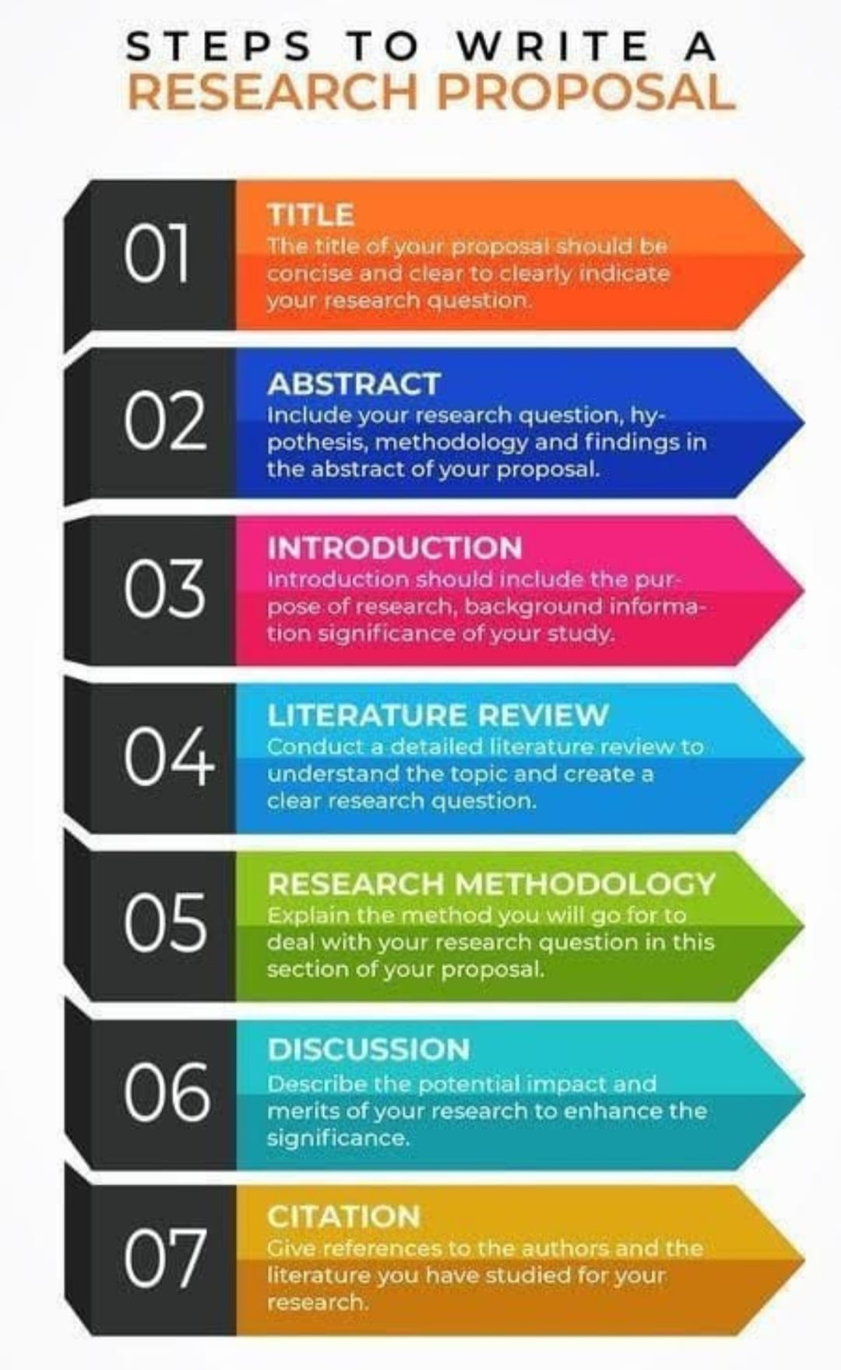

Slide 9
Research Proposal Content
A research proposal should contain the following information about your study:
an introduction, including a brief literature review, theoretical framework that underpins your study
objectives or research questions of your study
hypotheses to be tested, if applicable
study design that you are proposing to adopt setting for your study
research instrument(s) you are planning to use ethical issues involved and how you propose to deal with them
data processing procedures
problems and limitations of the study
proposed time-frame for the project

Slide 10
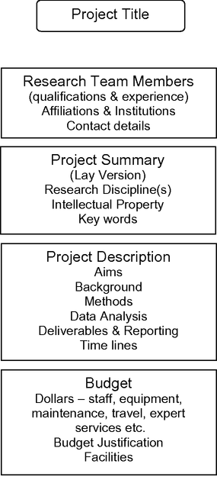
Generalized Form of a RP

Slide 11

Project Title
The title of a research project should be clear and specific. More than ten words are recommended for the title.
Acronyms should not be used as the assessment panel might not be familiar with their use
The title should indirectly indicate the science/engineering discipline of the research so that the readers can direct the project proposal to those who have relevant experience in the discipline.

Slide 12
Project Summary
While the project outline contains technical detail, the project team needs to convince the project assessment team that the project is worthy of funding.
Often the assessment team consists of generalists who do not have specific detailed knowledge of the research topic and the analysis methods proposed in the project outline.
Provide a short, clear statement about how the project will benefit their organization and how it fits into the goals and objectives of the research field.

Slide 13
Project Summary
Example:
An antenna team aims to design new antennas that will improve the range of small wireless sensors used in a nursing home.
The assessment team from the research granting authority might want to know the current and intended application of the wireless sensors and how an increased range will improve the lives of aged people living independently.
The project summary should also contain keywords so that the literature in the field can be thoroughly surveyed for competing technologies and research outcomes.

Slide 14
Background
Background information should justify the necessity of your project.
Do preliminary studies indicate that your project is necessary and feasible?
Literature review:
Include title of citation, authors, date, journal and page number
Check the citations for accuracy

Slide 15
Background…
Start with a very broad perspective of the main subject area, before gradually narrowing the focus to the central problem under investigation. In doing so, cover the following aspects of your study area:
an overview of the main area under study;
a historical perspective (development, growth, etc.) pertinent to the study area;
philosophical or ideological issues relating to the topic;
trends in terms of prevalence, if appropriate;
major theories, if any;
the main issues, problems and advances in the subject area under study;
important theoretical and practical issues relating to the central problem under study;
the main findings relating to the core issue(s).

Slide 16
Background…
A presentation of any pertinent data obtained in the investigator’s lab (if any)
Displayed in an organized fashion (tables, graphs and other figures)
Illustrates the skills and techniques available to the investigator
Includes a section of recent publications or manuscripts by the investigator

Slide 17
Problem Statement
Some of the main research questions that you would like to answer through your study should also be raised, and a rationale and relevance for each should be provided.
Specifically, this section should:
identify the issues that are the basis of your study;
specify the various aspects of/perspectives on these issues;
identify the main gaps in the existing body of knowledge;
raise some of the main research questions that you want to answer through your study;
identify what knowledge is available concerning your questions, specifying the differences of opinion in the literature regarding these questions if differences exist;
develop a rationale for your study with particular reference to how your study will fill the identified gaps.

Slide 18
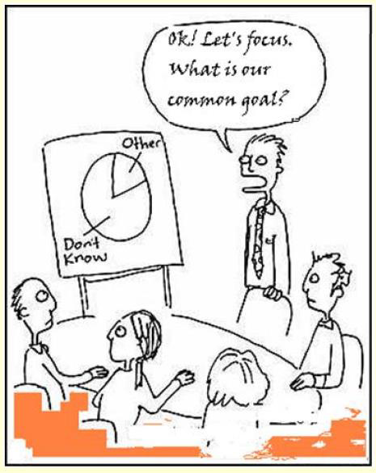
Objectives of the Study
The objectives of the study should be clearly stated and specific in nature.
Each sub-objective should delineate only one issue.
Use action-oriented verbs such as ‘to determine’, ‘to investigate’ and ‘to analyse’ in formulating sub-objectives, which should be numerically listed.

Slide 19
Objectives of the Study: Example
Problem Statement:
When will a MEMs based silicon micro-switch fail if it is exposed to the atmosphere?
Objectives:
To measure the surface contamination of silicon exposed to the atmosphere;
To measure the mechanical properties of a silicon beam when subjected to continued use;
To model the experimentally derived data using 3D multi-physics.

Slide 20
Measurement Procedures
Justify your choice of research tool, highlighting its strengths and pointing out its weaknesses.
Then outline the major segments of your research tool and their relevance to the main objectives of the study.
If you are using a standard instrument, briefly discuss the availability of evidence on its reliability and validity. If you adapt or modify it in any way, describe and explain the changes you have made.
Ideally, for quantitative studies you should attach a copy of the research instrument to your proposal.

Slide 21

Ethical Issues
All academic institutions are particular about any ethical issues that research may have.
To deal with them, all institutions have some form of policy on ethics.
You need to be acquainted with your institution’s policy. It is imperative that in your proposal you identify any ethical issues and describe how you propose to deal with them

Slide 22
Problems and Limitations
This section should list any problems you think you might encounter concerning, for example, the availability of data, securing permission from the agency/organisation to carry out the study, obtaining the sample, or any other aspect of the study.
Problems refer to difficulties relating to logistical details.
It is important to be aware of – and communicate – any limitations that could affect the validity of your conclusions and generalisations.

Slide 23
Research Plan, Methodology & Timing
Experimental design
Innovations
Limitations / anticipated difficulties
Alternative approaches
Time sequence

Slide 24
Research Plan ...
Organized sequentially by specific aims stated
A detailed description of proposed experiments including:
Rationale
Design
Anticipated results and
Alternative strategies
Should be planned to methodically address the specific questions stated under specific aims

Slide 25
Analysis of Data
In general terms, describe the strategy you intend to use for data analysis. Specify whether the data will be analysed manually or by computer.
For computer analysis, identify the program and where appropriate the statistical procedures you plan to perform on the data.
For quantitative studies also identify the main variables for cross-tabulation.
You need to specify which particular strategy you are proposing for data analysis for your study.

Slide 26
Significance, Outcomes & Innovation
Show how the results of your research will fill identified gaps in existing knowledge. Will the results of your research have benefits the country and/or the funding agency?
Provide a list of deliverables which will arise from the project. Deliverables are things which can be accessed by others such as reports, software code, presentations, images, etc.
Reports, presentations, patents, designs, objects, etc. can be delivered to the granting authority as an indication of progress in the research project.
New knowledge is only created when it is publicly available. In some cases, the research team might specify the conferences and journals where their results will be disseminated.

Slide 27
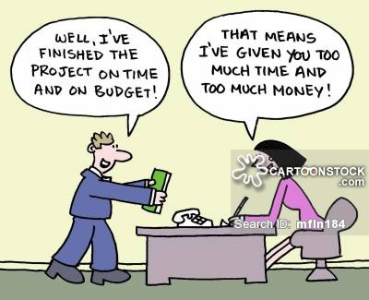
budget
The budget is a very important aspect of the research proposal. The research plan must be a cost effective strategy for the interested partners.
Don’t inflate figures
An inflated, unjustified budget is likely to result in no funding or reduced funding of the project.
Make accurate calculations
Direct Costs
can be specifically documented, eg:
salaries;
operating expenses (printing, consumables);
travel (mileage, fares, lodging, sustenance);
equipment;
etc. ..

Slide 28
Budget…
Indirect Costs
real costs that cannot be easily identified as specific to a particular project, eg:
utilities;
maintenance of space and equipment;
security;
computer services;
legal services;
accounting services;
payroll services.

Slide 29
Budget Justification
Justify every item. Do not merely restate proposed expenditure.
The justification of the budget must match the research methods and analysis outlined in the research proposal.
Explain why the project could not proceed/would not be successful without these items

Slide 30
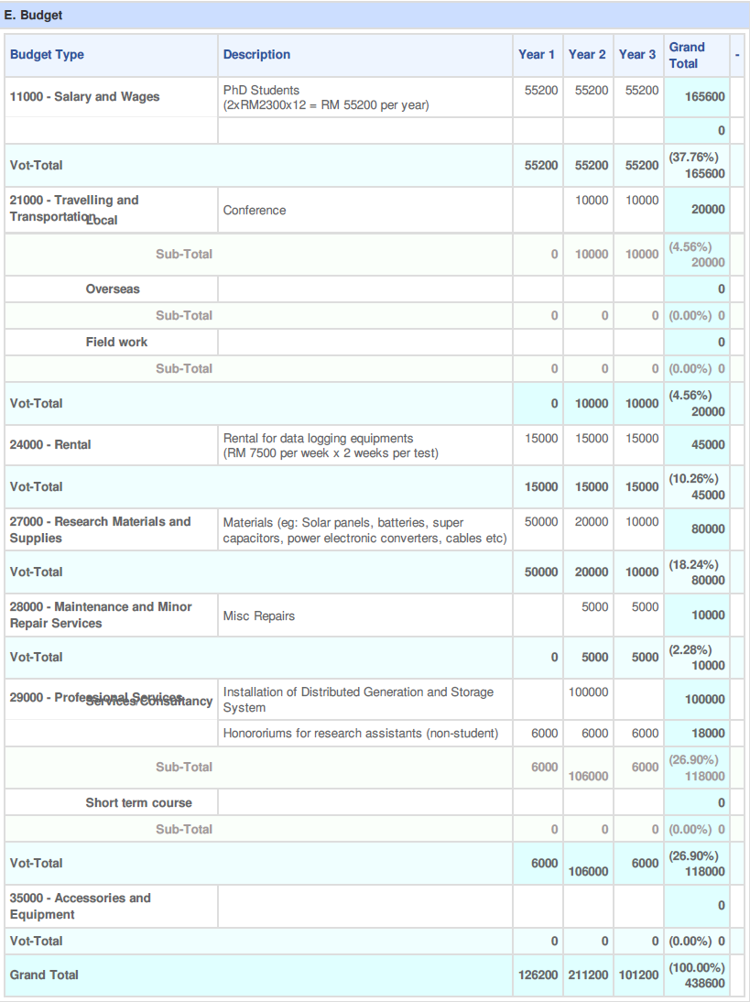

Slide 31
Conflict of Interest
When a research team receives funding from a commercial partner, some ethical issues might arise
In particular, researchers must ensure that the results are presented in an unbiased manner and that all conflicts of interest are clearly stated in any publications, presentations and reports
This can be done in the acknowledgements section of the published paper

Slide 32
Research Team
It is rare for a project to involve only one researcher.
The project leader (often called the Chief Investigator or Principal Investigator) should take the lead in approaching people who will make a substantial contribution to the project.
The project leader is the person who will manage the project in all respects, who will be responsible for the expenditure of the budget, ensure that the milestones are met and the project outcomes are delivered.

Slide 33
Research Team…
In higher education for a PhD thesis, the project leader is usually the research student, however, the thesis topic is commonly initiated by the primary academic supervisor.
–Commonly students do not control the expenditure of research funds. This is usually the responsibility of the primary supervisor.
If the project contains many co-researchers and collaborators:
Explain the roles of each participant in the project.
Include MoU/MoA/LOI in the proposal when collaborating with other institution/industry

Slide 34
Research Schedule
You must set yourself dates as you need to complete the research within a certain time-frame.
List the various operational steps you need to undertake and indicate against each the date by which you aim to complete that task.
Remember to keep some time towards the end as a ‘cushion’ for unforeseen circumstances.
In a research project, there is a long and unexpected delay in the delivery of a test instrument.
Develop a chart.

Slide 35
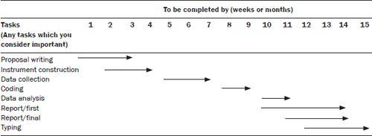
Gantt Chart

Slide 36
Research Timelines
Simple representation of timelines for a project. The crosses represent major time requirements.
Q refers to one quarter of one year. Only the major deliverables should be included.
The work titles must be specific (not generic as presented in this illustration).

Slide 37
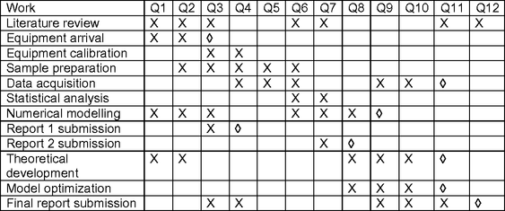
Research Timelines…

Slide 38
Appendix
Include relevant publications/ manuscripts in preparation from your lab
Any detailed experimental protocols/methods that are too long to include in the grant
In the case of quantitative studies, attach your research instrument.
Attach flowchart of your research activities

Slide 39
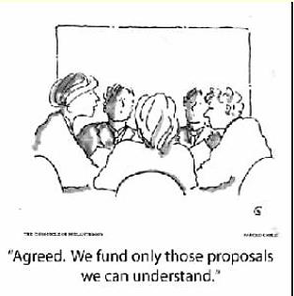
Reasons for Rejection
Absence of innovative ideas or hypothesis
Will provide only an incremental advance
Not exciting or cutting edge
Errors
Unclear or incomplete expression of aims
Faulty logic or experimental design
Less than rigorous presentation

Slide 40
Reasons for Rejection
Unrealistic, sloppy or incomplete
Resources and facilities not in place
PI qualifications/expertise not evident
Necessary collaborations not documented

Slide 41
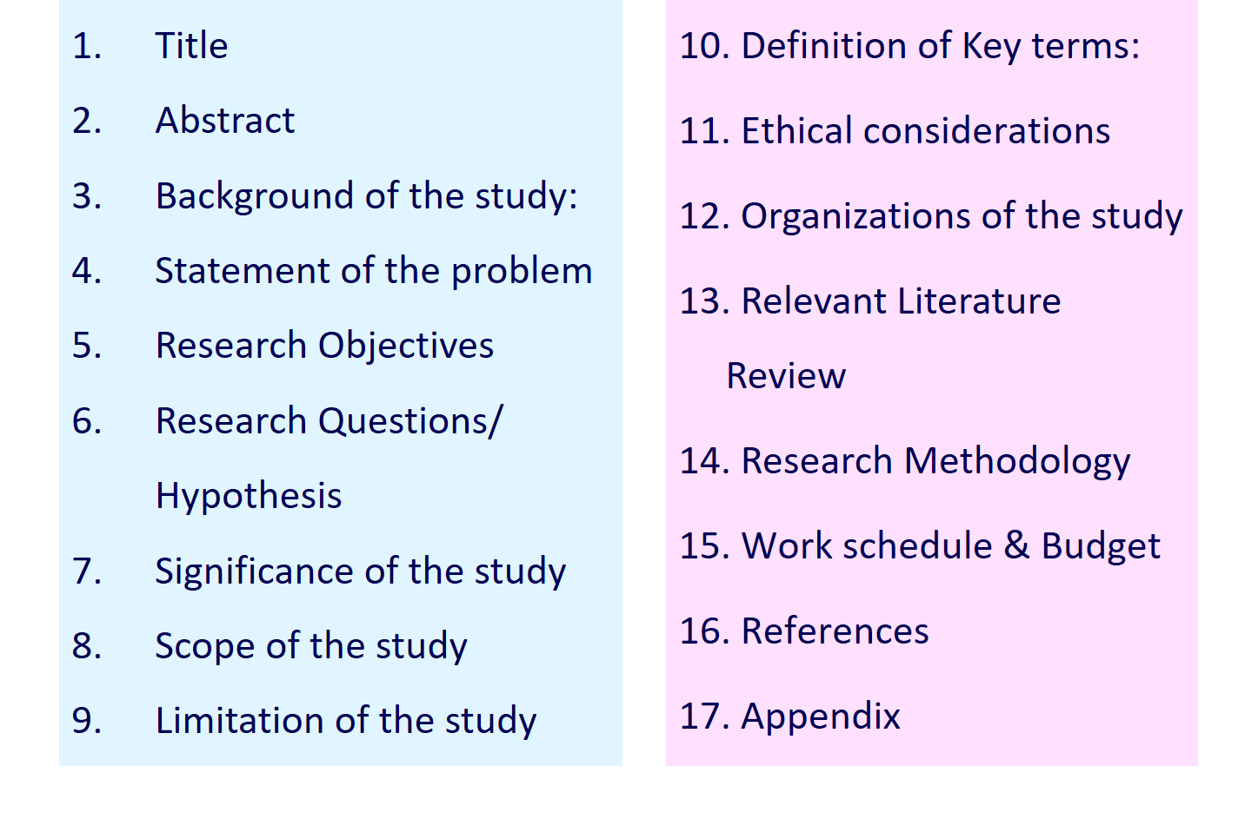
COTENTS OF RESEARCH PROPOSAL

